Slide 1
Angular Material
Layout Component
Lecture 3
By James(Jin) Wang
10/06/2022

Slide 2
Outline
Flexbox
Application Routes
Sidenav Component
Add Responsiveness

Slide 3
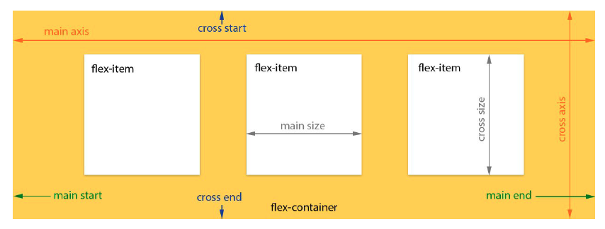
Flexbox
  Flex Layout Box Model and Terminology

Slide 4
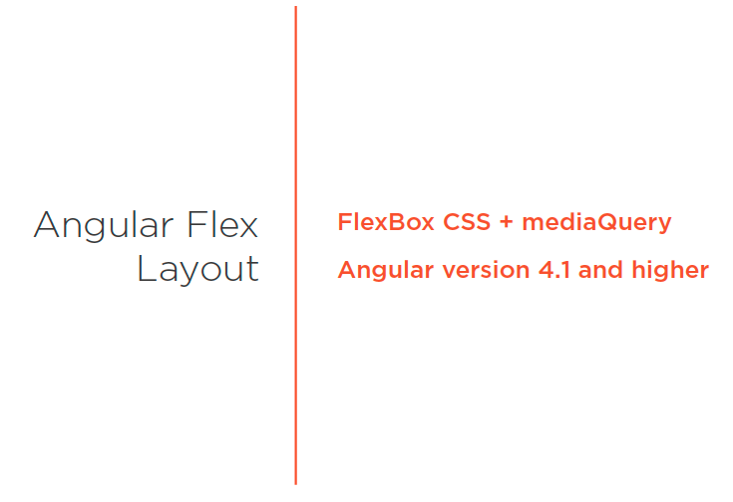
Flexbox
  Angular Flex Layout

Slide 5
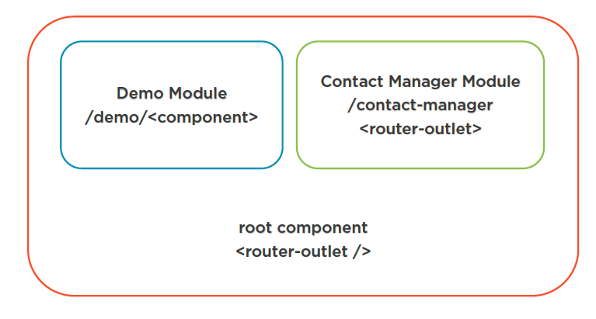
Application Routes
  Application Routes

Slide 6
Application Routes
  Application Routes
  ng g m demo/demo --flat --routing
  ng g c demo/buttons --skip-tests

Slide 7
Application Routes
  Application Routes
  add Routes to app-routing.module
  add Routes to demo-routing.module

Slide 8
Application Routes
  Application Routes
  ng g c demo/flexbox --skip-tests
  Demo: demo module

Slide 9
Application Routes
  Flexbox
  npm i -s @angular/flex-layout
  flexbox.component
  Demo: flexbox component

Slide 10
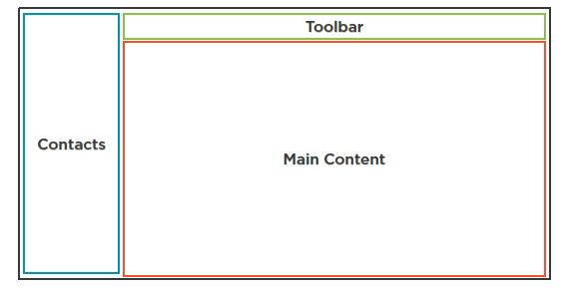
Application Routes
  Contact Manager Layout
  ng g m contactmanager --routing
  ng g c contactmanager/contactmanager --skip-test

Slide 11
Application Routes
  Scaffold the App
  ng g c contactmanager/components/toolbar --skip-test
  ng g c contactmanager/components/main-content --skip-test
  ng g c contactmanager/components/sidenav --skip-test
  Demo: scaffold the app

Slide 12
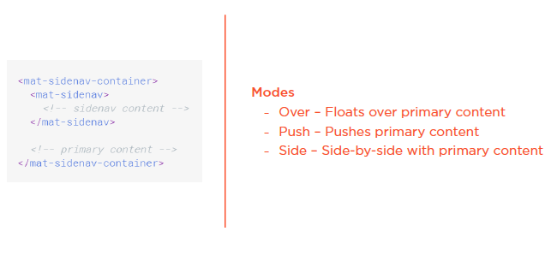
Sidenav Component
  Sidenav Component

Slide 13
Sidenav Component
  Sidenav Styling
  https://material.angular.io/components/sidenav/overview
  edit sidenav.component.html
  Demo: sidenav component

Slide 14
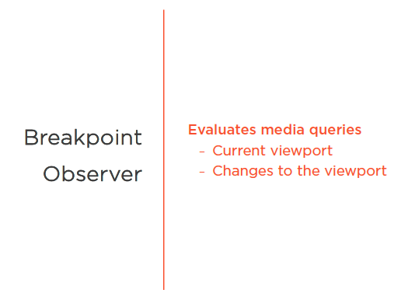
Responsiveness
  Breakpoint Observer

Slide 15
Responsiveness
  Add Responsiveness
  edit sidenav.component.ts
  Demo: sidenav add responsiveness

Slide 16
Responsiveness
  Create toggle button
  edit sidenav.component.html
  edit toolbar.component.html
  edit toolbar.component.ts
  edit toolbar.component.scss
  Demo: create toggle button

Slide 17
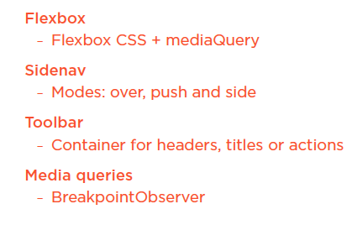
Summary

Slide 18
Assignment

Slide 19
Self Study
  Styling Application with Angular Material
  https://app.pluralsight.com/library/courses/angular-material

